Slide 1


Classification of Air Pollution Levels using Supervised Machine Learning Algorithms

Slide 2
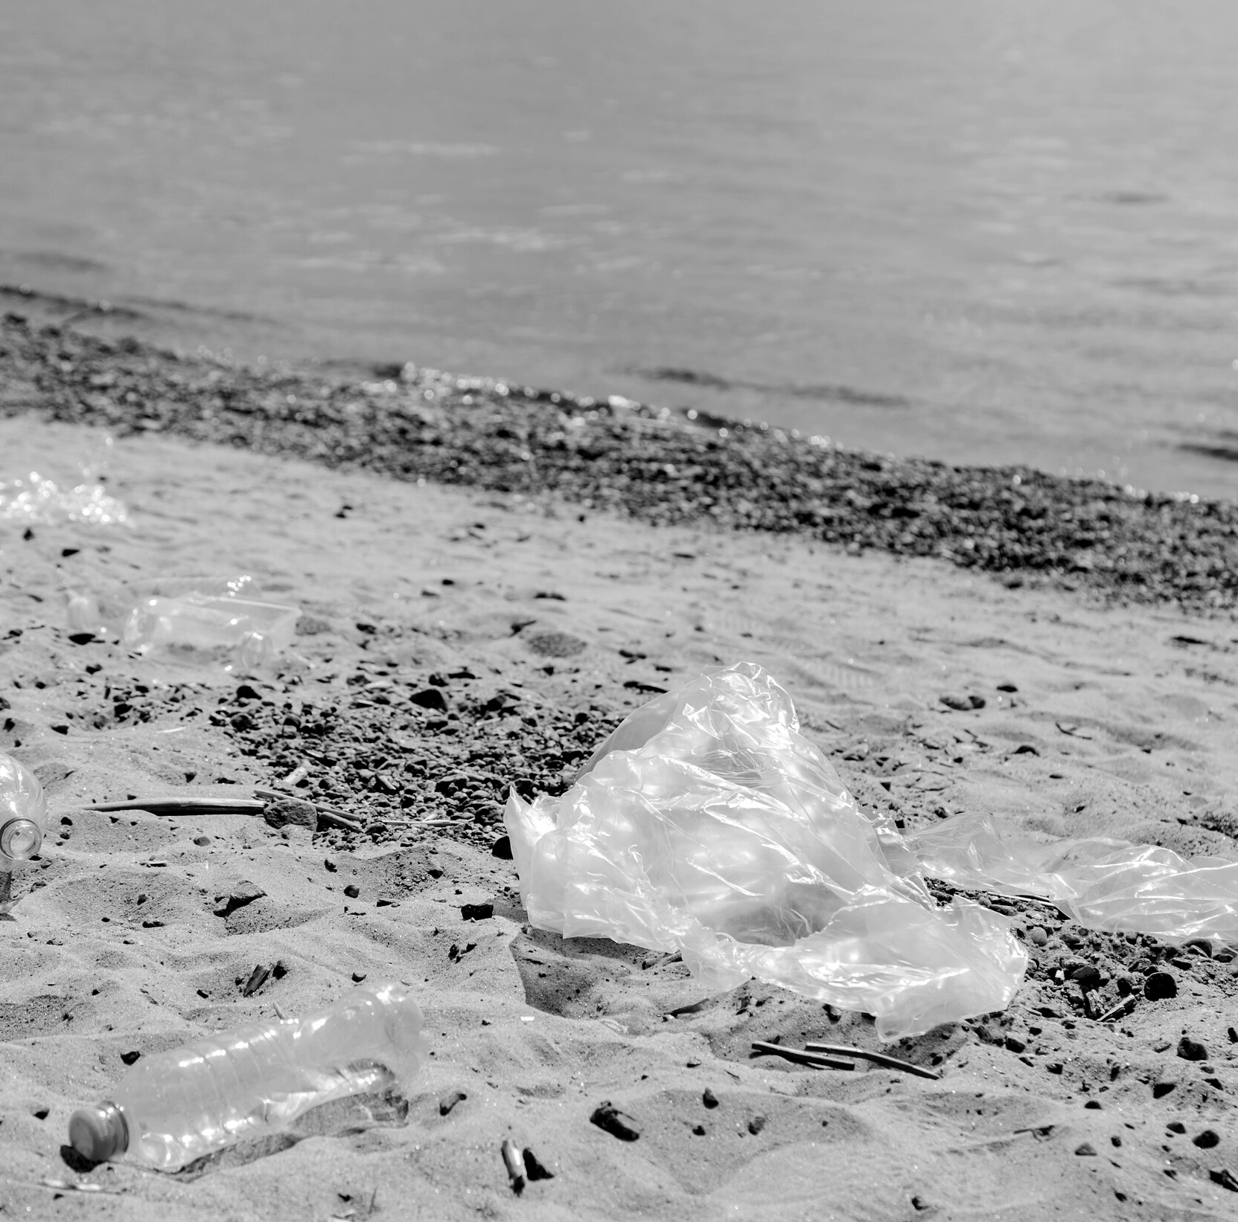
Content.
Introduction.
Problem Statement.
Proposed Solution.
Modules.
System Requirement.
Work completed.
Conclusion.
References.

Slide 3
Introduction
Air pollution is one of the world's most serious environmental problems. It is a major threat to both human health and the environment.
The quality of air in cities is deteriorating on a daily basis.
We need to develop an efficient and accurate prediction/forecasting system to make future air quality predictions.
This will help us take necessary mitigation steps and prepare.
There are many reasons including the amount of gases and pollutants in the air.
We need to collect data and develop solution.

Slide 4
Introduction
Existing systems are statistical method based and they are not accurate.
Machine learning models/algorithms performs well in predicting anything from dependant features - once trained, these algorithms can make accurate predictions of future.

Slide 5
Problem Statement
Daily pollutant amount and air quality data are available for all cities in India.
We need to utilize this data to develop a machine learning model to predict the air quality of a particular day accurately and guess its severity, and other details.
We need to train ML models using this data.
We need to develop web app with the air quality prediction model at the backend.

Slide 6
Proposed Solution
We collect air pollution and pollutant data of different cities in India day by day from sources like kaggle.com.
Clean and preprocess the data.
Develop and train ML models with the data.
Test the data.
Develop HTML and CSS based multi-page web app with facilities like login/signup, predict air quality, get precautions, etc.
Integrate the trained model and the web app.

Slide 7
Modules
Admin/Login/Signup Module - For the user to register and login.
Air Quality prediction module - The user entered details will be sent to the trained model at the backend - the model will accurately make prediction.
Result and mitigation measures module - Will be recommending the mitigation strategies, and pointing health concerns regarding the air quality and different pollutant measures.

Slide 8
System Requirements
Backend Development:
Language - Python 3.10
IDE: Google Colab platform.
and python libraries like numpy, pandas, sk-learn, etc.
Front-end development:
HTML for designs, layout, pages and CSS for styles, fonts, etc.
Python Flask API for frontend backend integration.
Hardware requirement - not specific.

Slide 9
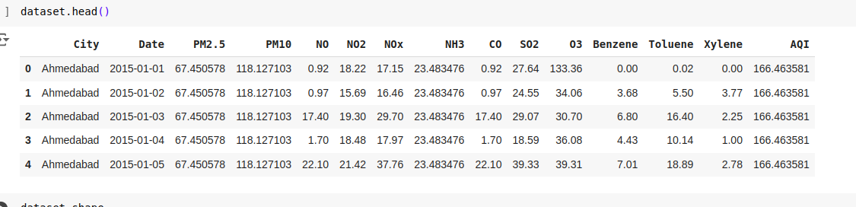
Work Completed
Data collected from www.kaggle.com
Analyzed and preprocess the dataset using python.
Details of the dataset.
Total 29531 samples are available.
Details like City, Date, etc available.

Slide 10
Work Completed
Checked data types.
Checked missing values and replaced them with mean of the columns.
26 cities available - Ahmedabad, Aizawl, Amaravati, Amritsar, Bengaluru, Bhopal, Brajrajnagar, Chandigarh, Chennai, Coimbatore, Delhi, Ernakulam, Gurugram, Guwahati, Hyderabad, Jaipur, Jorapokhar, Kochi, Kolkata, Lucknow, Mumbai, Patna, Shillong, Talcher, Thiruvananthapuram, Visakhapatnam.
Data from year 2015 to year 2020 available.
Selected only 9 features (pollutants):
'PM2.5', 'PM10', 'NO', 'NO2', 'NOx', 'NH3', 'CO', 'SO2', 'O3'

Slide 11
Work Completed
Trained the Linear Regression algorithm - This algorithm will learn the dependant features (amount of pollutants present that day) and correlate it to the value AQI (Air Quality Index).
Trained the model with the dataset.
Trained model 2: XGBoost (Extreme gradient Boost) algorithm - advanced version of Linear Regression model for better accuracy and low loss value.
Trained model performance:
Linear regression: Mean square error= 2946.42, R-square error = 0.8045
XGBoost: Mean square error= 1448.81, R-square error = 0.90389
Saved the trained models for future use.

Slide 12
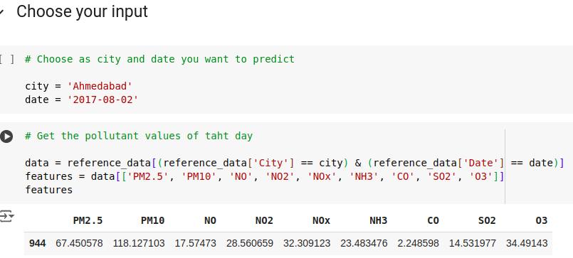
Work Completed
Tested the model in Google Colab.

Slide 13
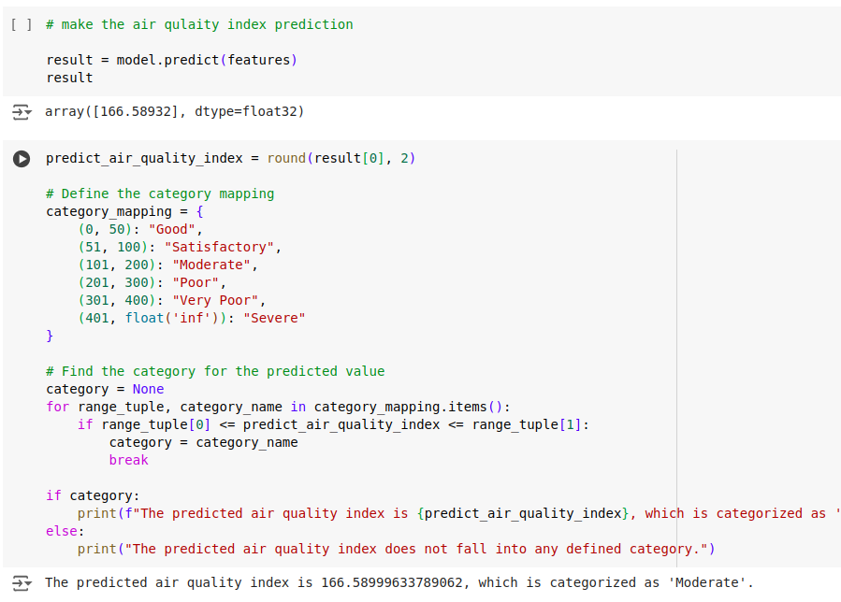
Work Completed
Tested the model in Google Colab.

Slide 14
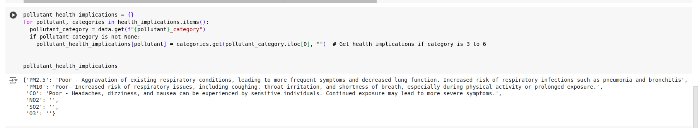
Work Completed
Tested the model in Google Colab.

Slide 15
Work Completed
The web app development
The front-end pages has been developed in HTML.
CSS is used for styles, fonts, layouts, etc.
API connected using Python Flask.
Hosted in ngrok.com platform for free.
Run in Google Colab.
Multiple pages are designed and developed.
Pages - landing, login, signup, home page, dashboard, precautions, about us, index page, and result page.

Slide 16
Work Completed
The web app development
Main html functions used - button, text field, url_for , etc.
Routing functions in Flask is used to navigate from pages to pages.
free API key from ngrok is used for hosting.

Slide 17
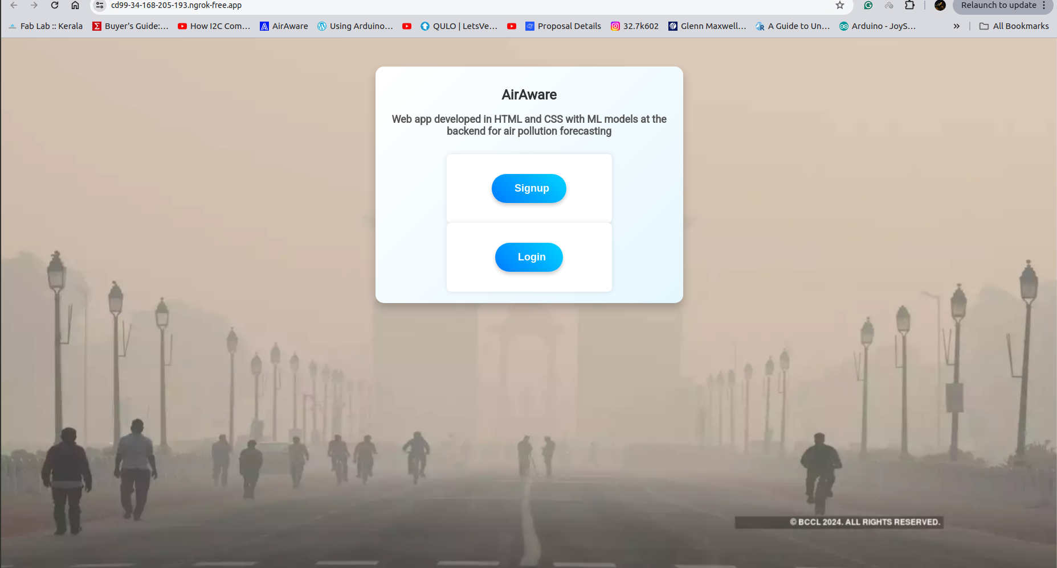

Slide 18
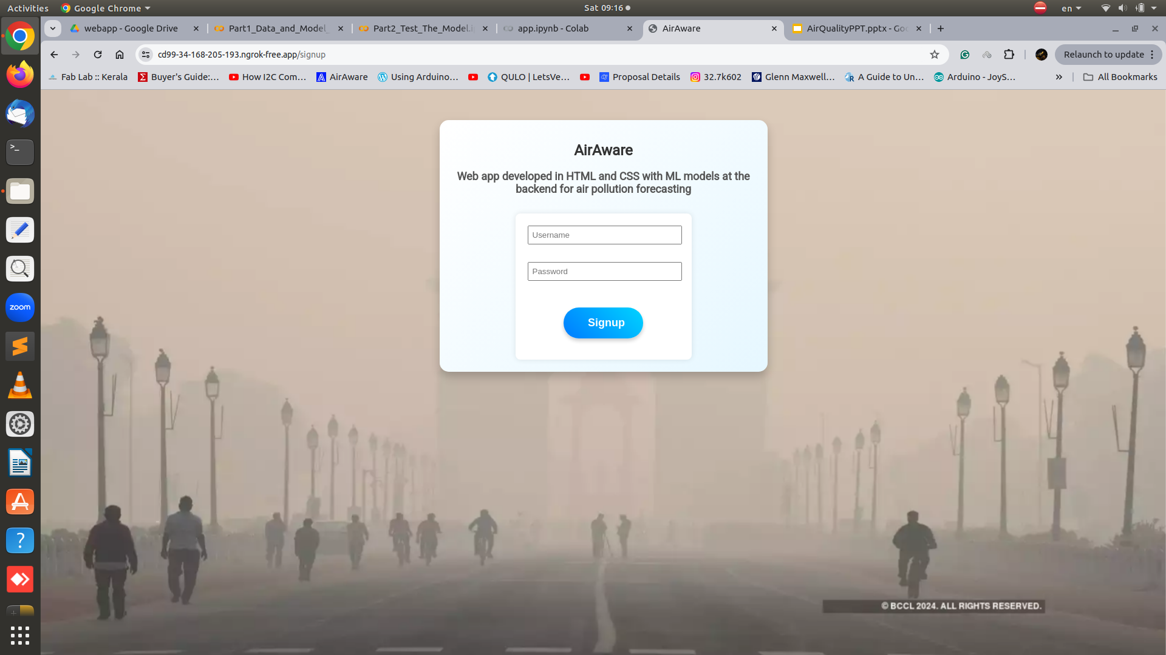
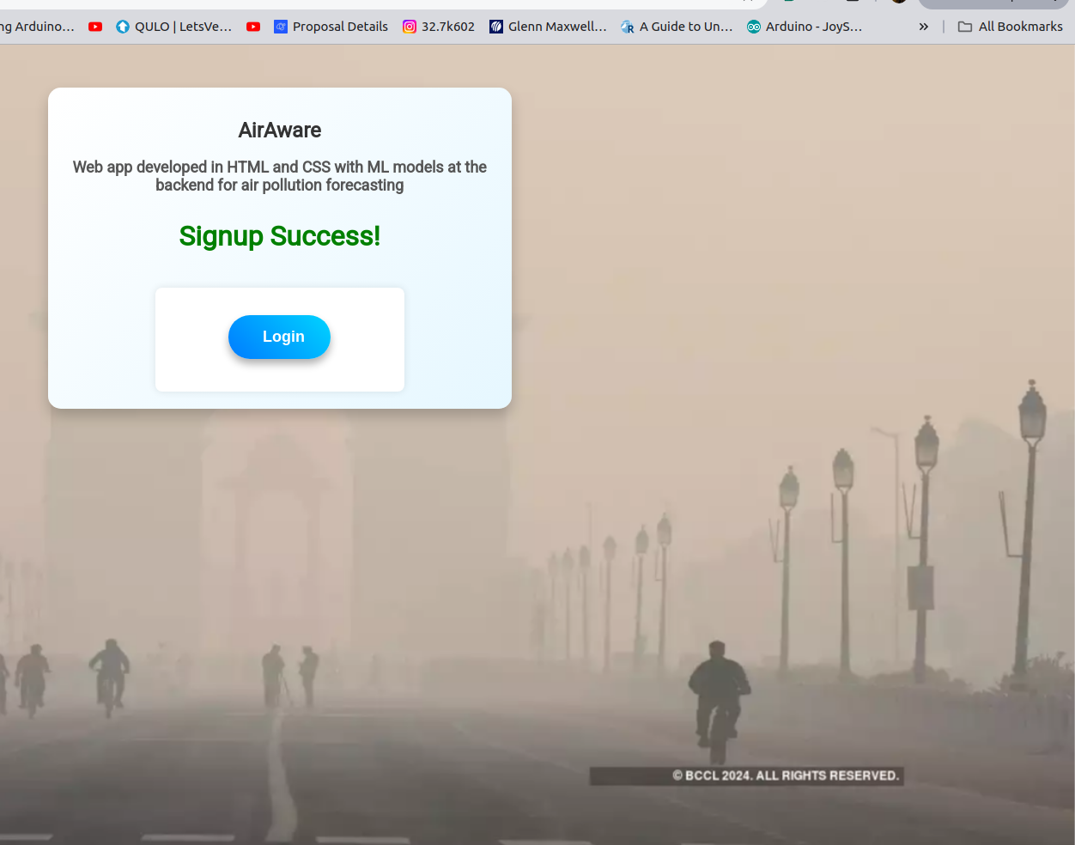

Slide 19
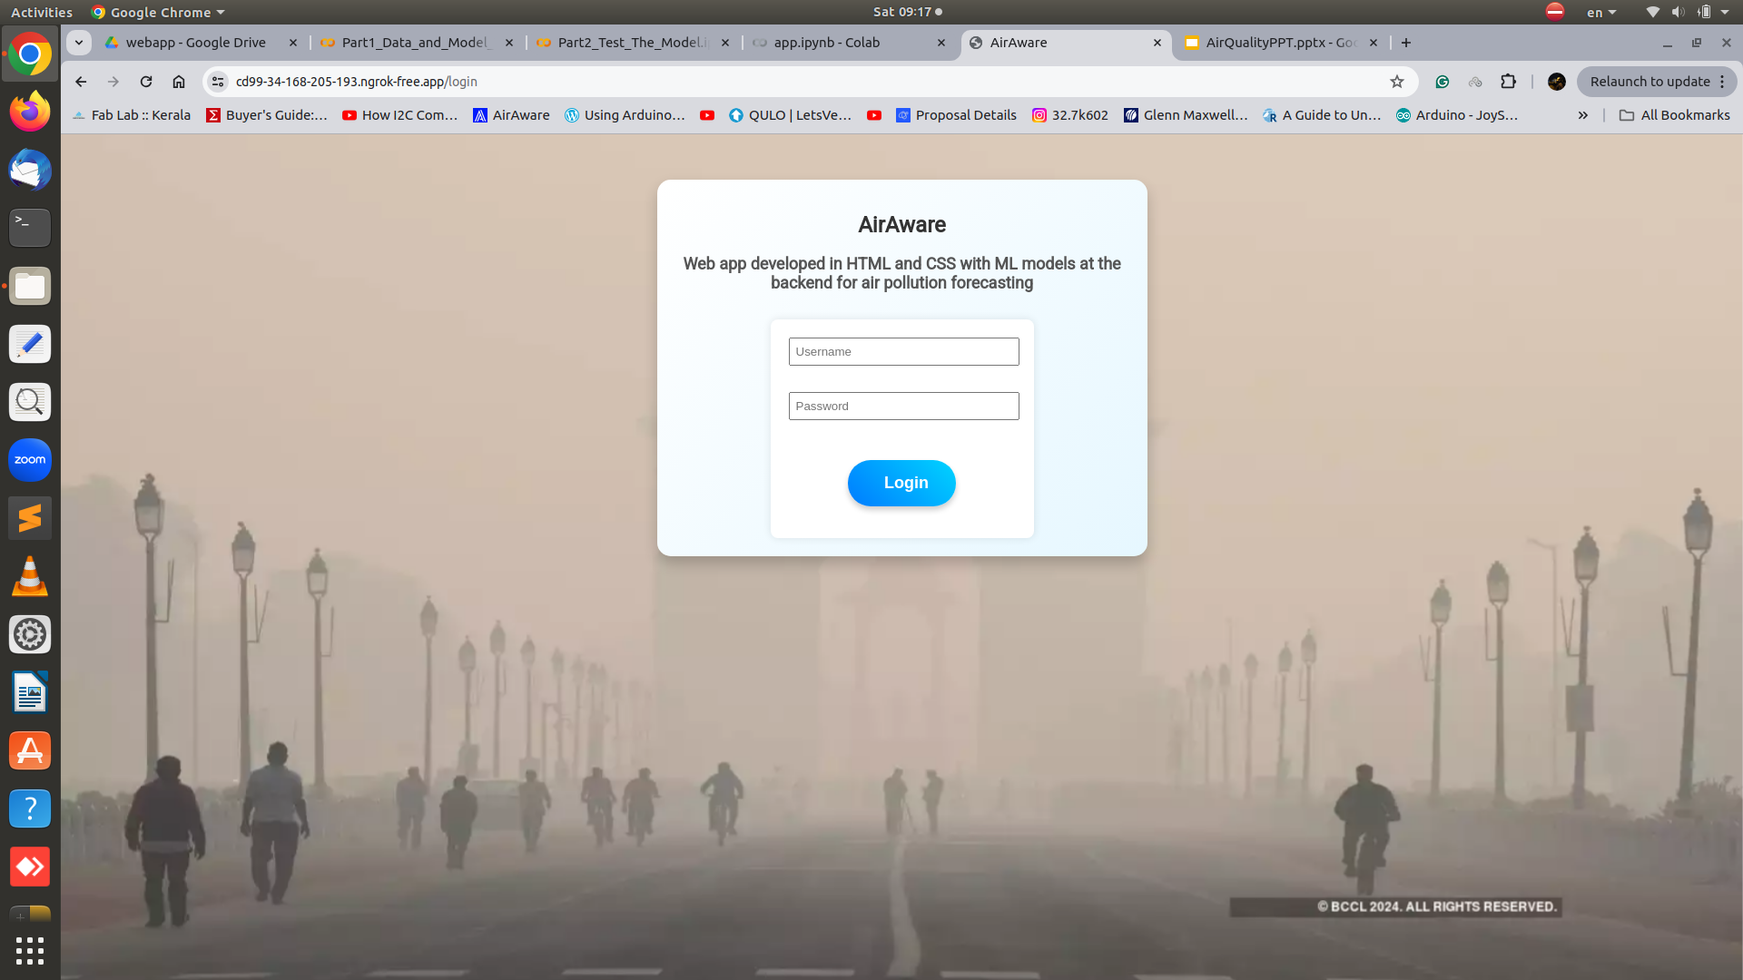
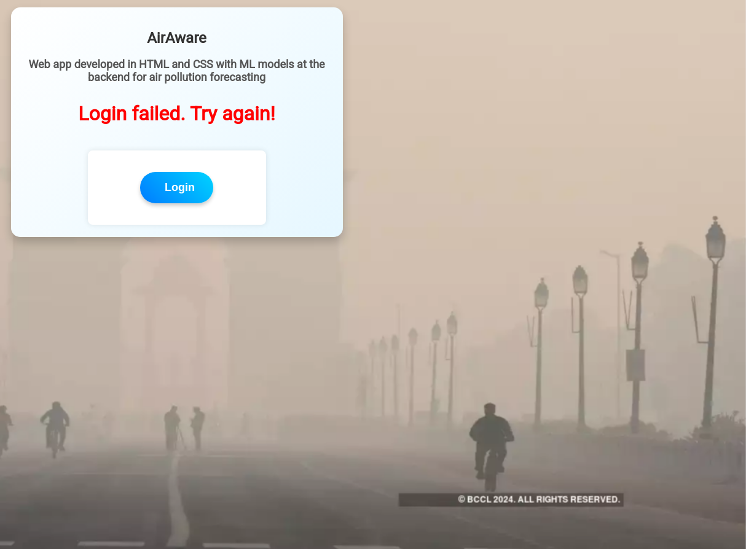

Slide 20
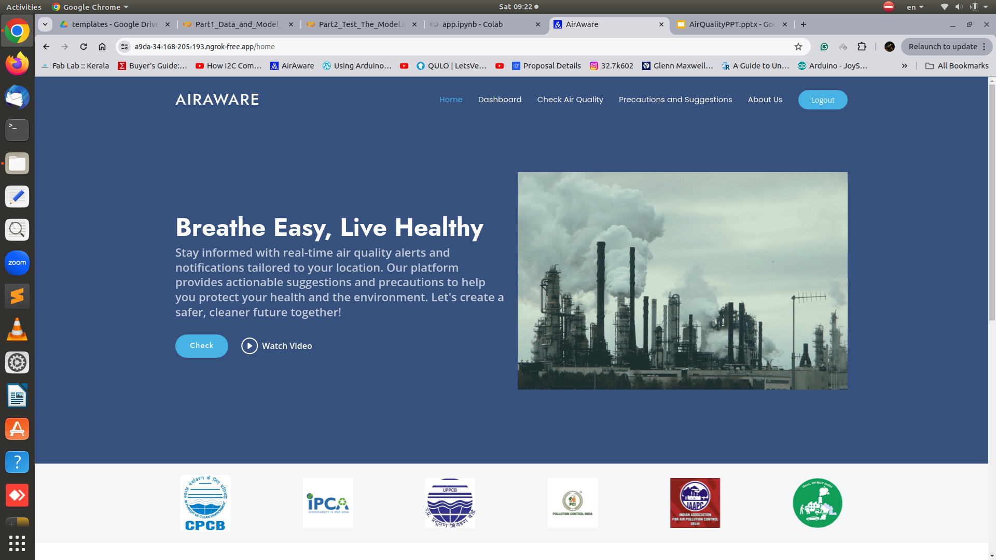

Slide 21
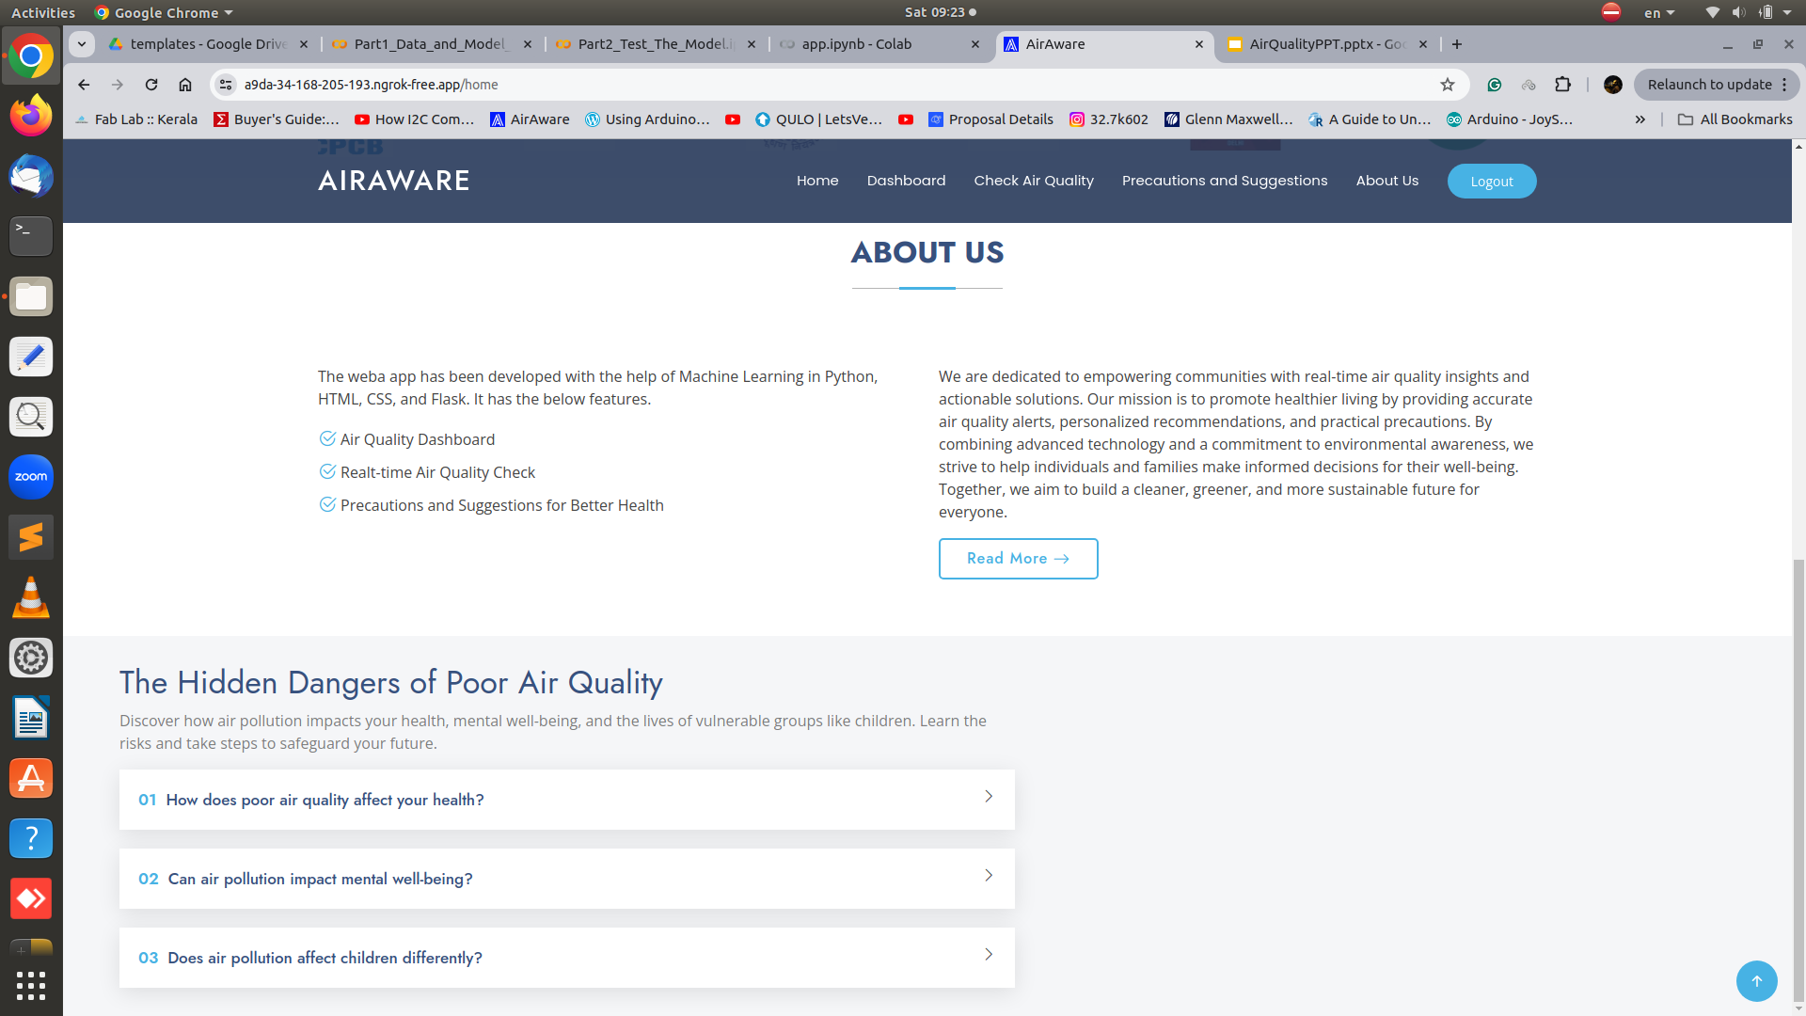

Slide 22
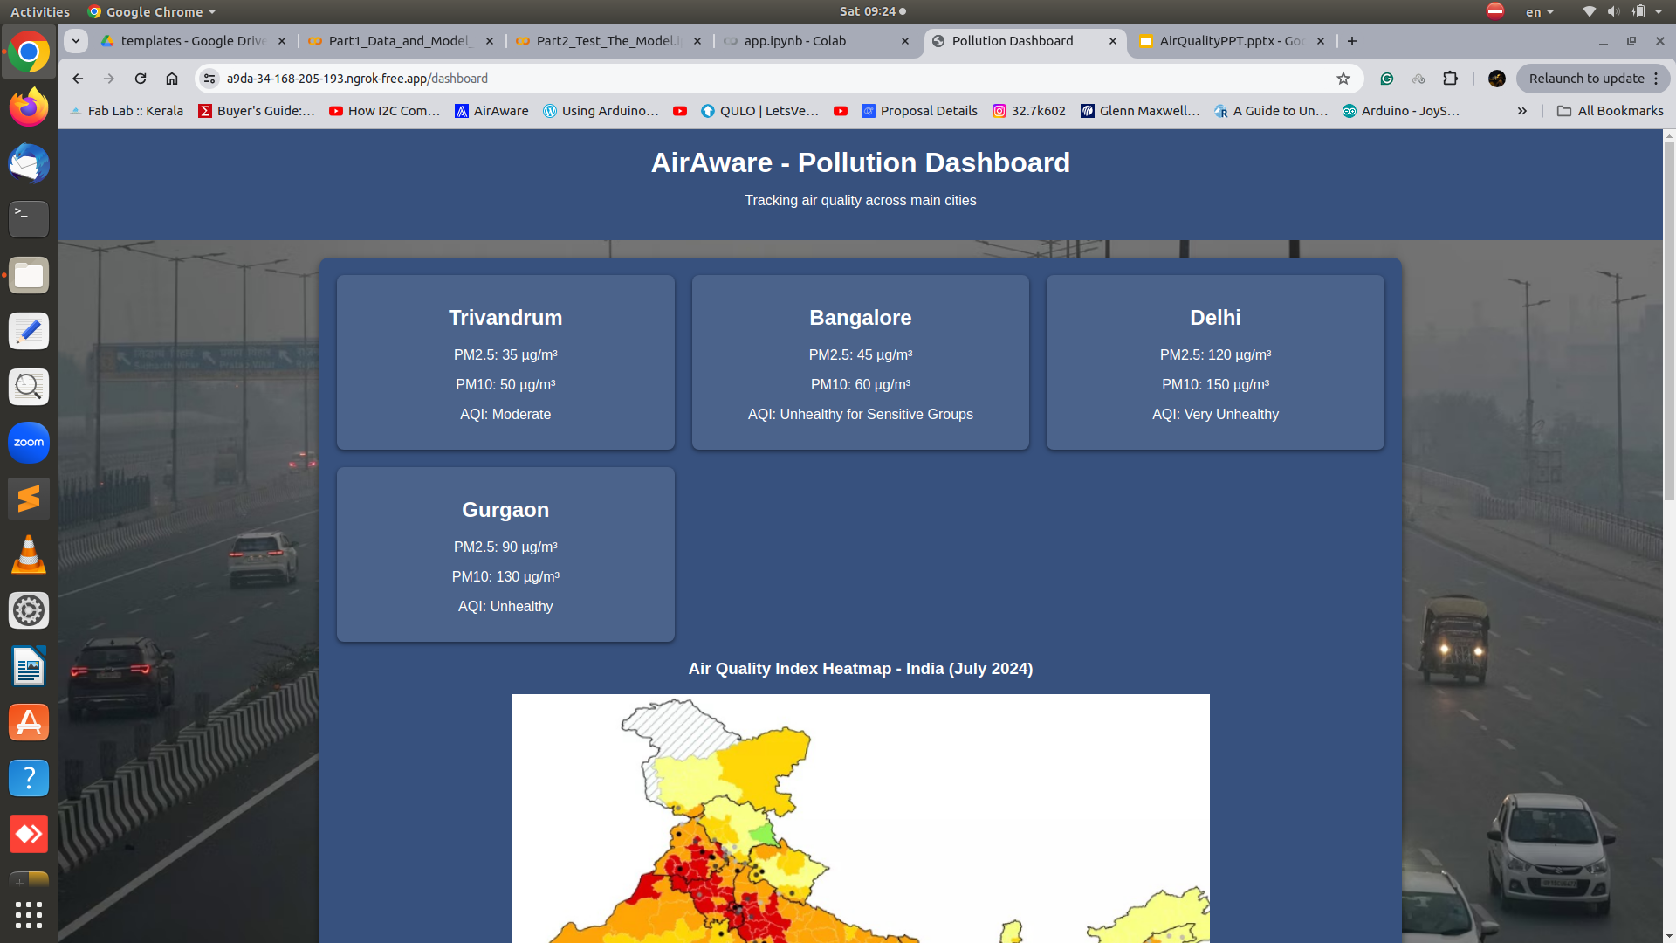
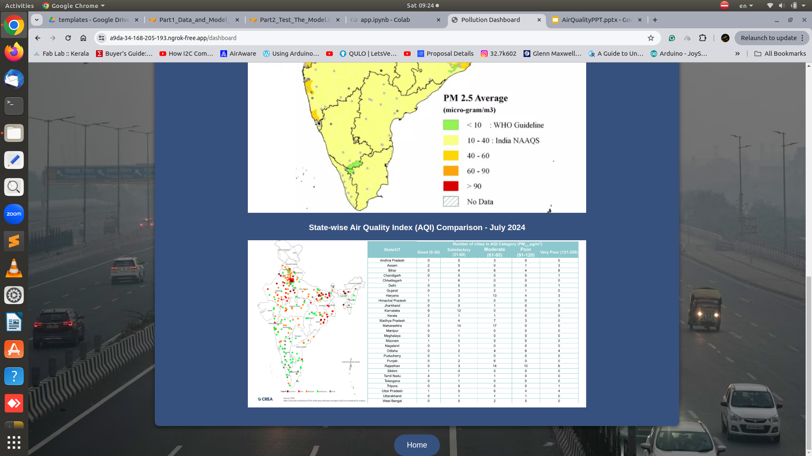

Slide 23
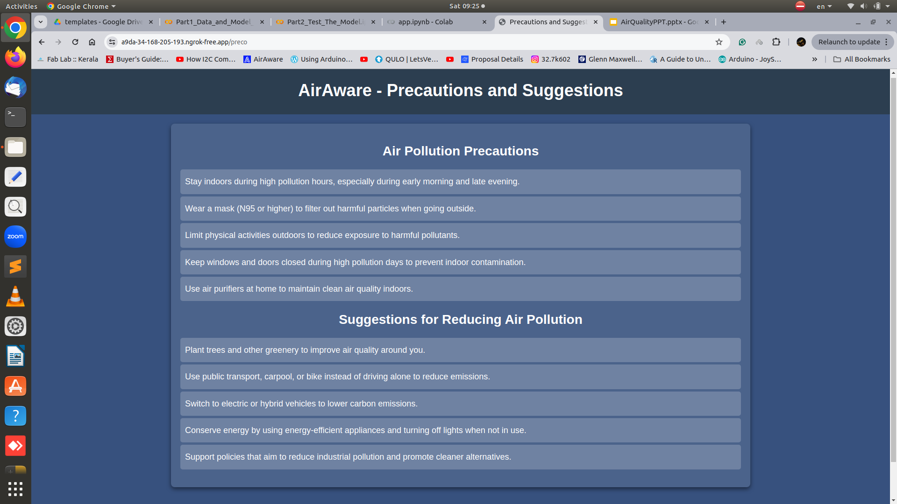

Slide 24
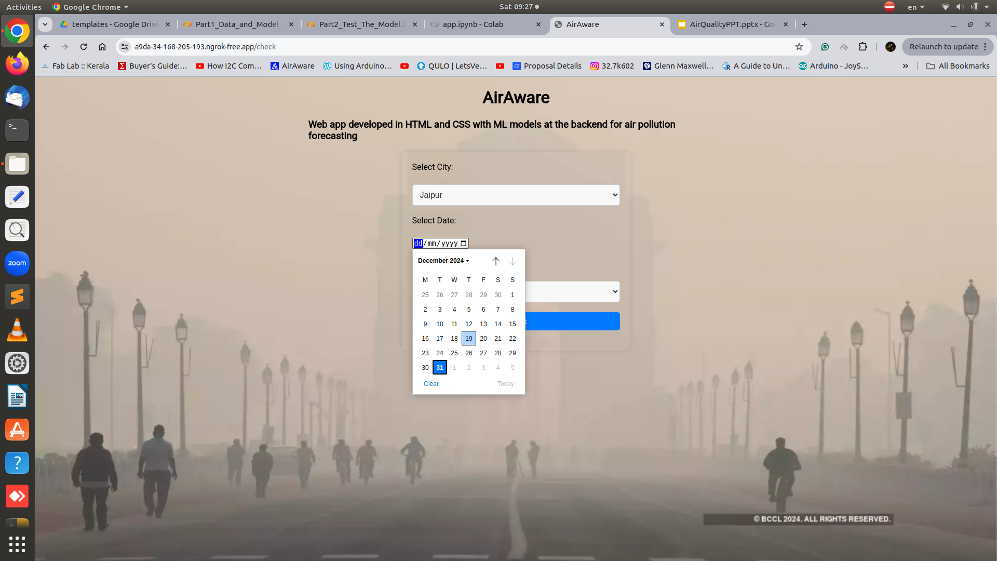

Slide 25
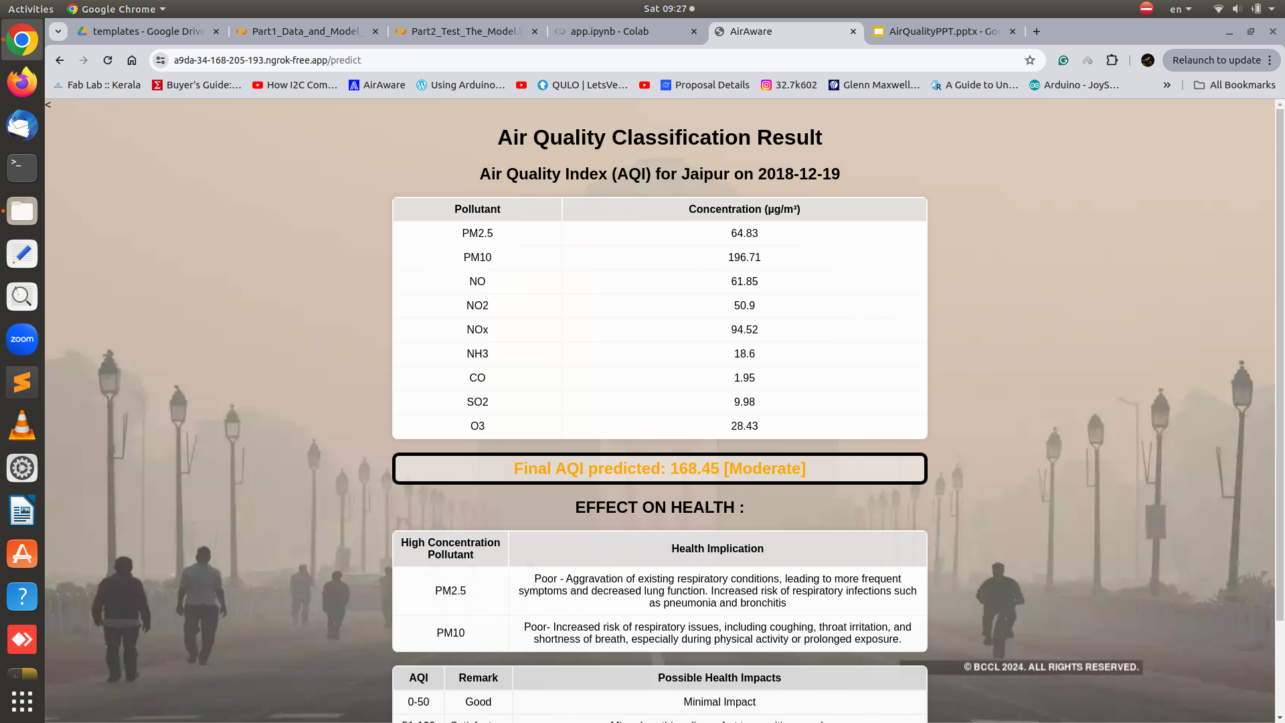
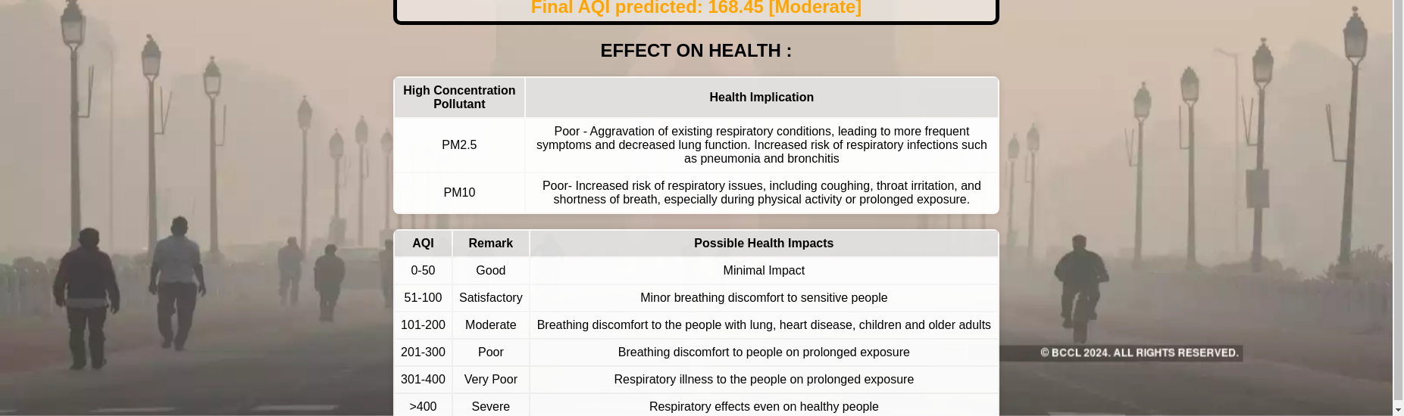

Slide 26
Conclusion
This project demonstrates the potential of machine learning in accurately predicting air quality using diverse environmental and pollutant data.
The model can serve as a valuable tool for policymakers, researchers, and individuals to address air pollution challenges.
The web app can be improved with features like daily AQI forecasting with some paid API from govt departments or private agencies.
The model can be improved by adding more recent data from these agencies in future.
We can add other forecasting like rain and wh

Slide 27
References
D. Komarasamy, N. G. C, N. S, N. P. L, Mohanasaranya and K. K, "Air Quality Prediction and Classification using Machine Learning," 2023 7th International Conference on Computing Methodologies and Communication (ICCMC), Erode, India, 2023, pp. 187-191, doi: 10.1109/ICCMC56507.2023.10083760.
E. Abdelfattah and Y. Ashkenazi, "Classifying Air Quality Using Machine Learning Models," 2023 IEEE 14th Annual Ubiquitous Computing, Electronics & Mobile Communication Conference (UEMCON), New York, NY, USA, 2023, pp. 0459-0463, doi: 10.1109/UEMCON59035.2023.10316018.
K. M. O. V. K. Kekulanadara, B. T. G. S. Kumara and B. Kuhaneswaran, "Machine Learning Approach for Predicting Air Quality Index," 2021 International Conference on Decision Aid Sciences and Application (DASA), Sakheer, Bahrain, 2021, pp. 622-626, doi: 10.1109/DASA53625.2021.9682221.
N. Z. Bogdanović, M. T. Koprivica and G. B. Marković, "Machine Learning for Air Quality Classification in IoT-based Network with Low-cost Sensors," 2021 15th International Conference on Advanced Technologies, Systems and Services in Telecommunications (TELSIKS), Nis, Serbia, 2021, pp. 303-306, doi: 10.1109/TELSIKS52058.2021.9606379.
S. K. Sunori, P. Juneja, P. B. Negi, S. Maurya, P. Raj and D. Nainwal, "AI and Machine Learning Based Classification of Air Quality Index Using COVID-19 Lockdown Period Data," 2021 2nd International Conference on Smart Electronics and Communication (ICOSEC), Trichy, India, 2021, pp. 896-904, doi: 10.1109/ICOSEC51865.2021.9591898.

Slide 28
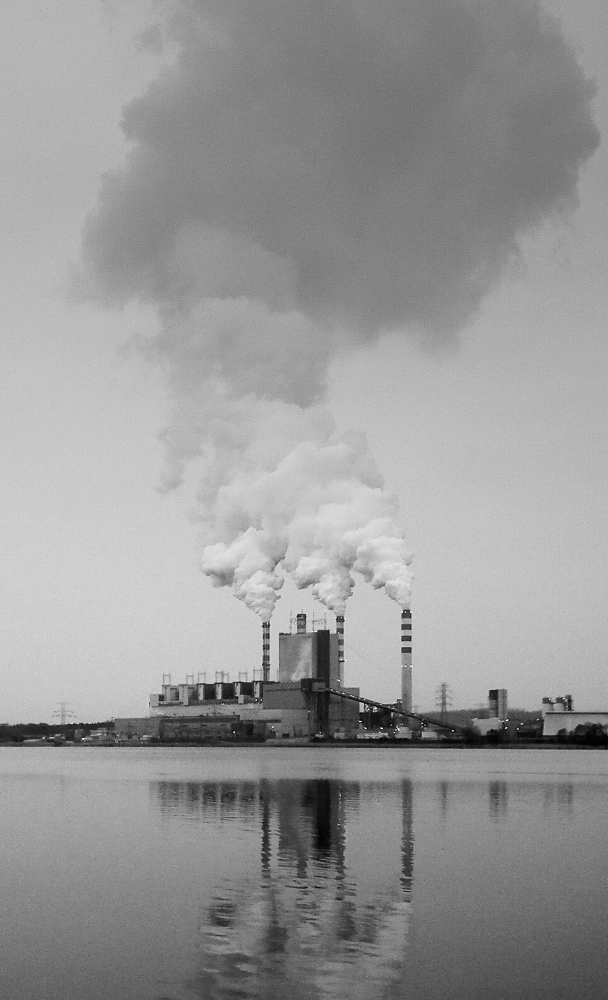
Thank you.

